Slide 1
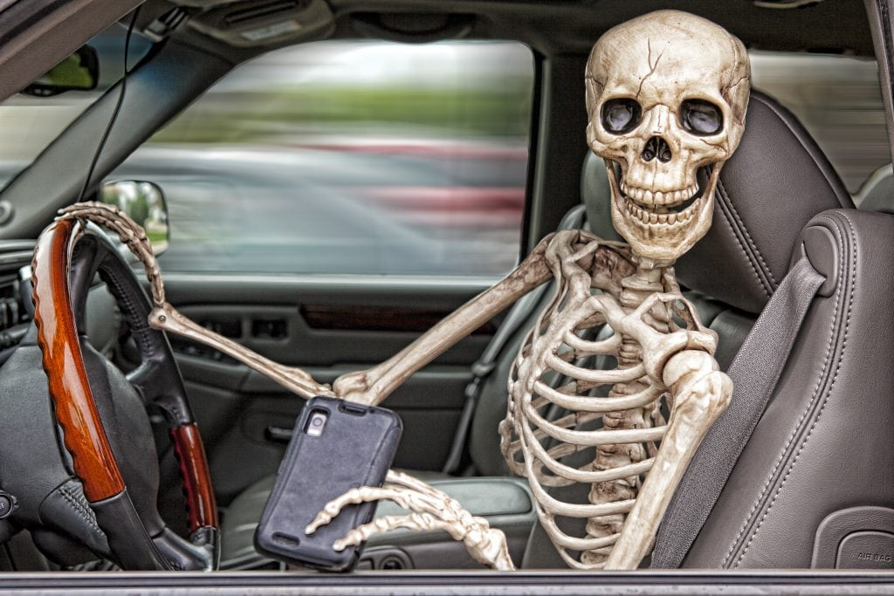
Distracted Driving
OFFICE OF SAFETY

Slide 2
Education
The best way to end distracted driving is to educate all Americans about the danger it poses.

Slide 3
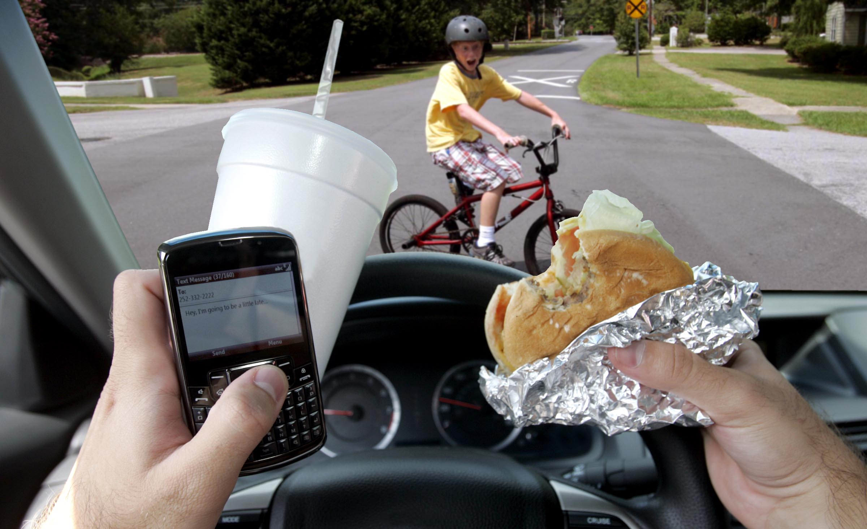
Definition
What is DISTRACTED DRIVING?
Distracted driving is any activity that could divert a person's attention away from the primary task of driving. All distractions endanger driver, passenger, and bystander safety.

Slide 4
Types
Texting
Using a cell phone or smartphone
Eating and drinking
Talking to passengers
Grooming
Reading, including maps
Using a navigation system
Watching a video
Adjusting a radio, CD player, or MP3 player

Slide 6
Facts
The number of people killed in distraction-affected crashes was 3,328 in 2012
An estimated 421,000 people were injured in motor vehicle crashes involving a distracted driver, this was a nine percent increase from the estimated 387,000 people injured in 2011.

Slide 7
Facts
10% of all drivers under the age of 20 involved in fatal crashes were reported as distracted at the time of the crash. This age group has the largest proportion of drivers who were distracted.

Slide 8
Facts
A quarter of teens respond to a text message once or more every time they drive. 20 percent of teens and 10 percent of parents admit that they have extended, multi-message text conversations while driving. (University of Michigan Transportation Research Institute)

Slide 9
Facts
At any given daylight moment across America, approximately 660,000 drivers are using cell phones or manipulating electronic devices while driving, a number that has held steady since 2010. (National Occupant Protection Use Survey)

Slide 10
Facts
Headset cell phone use is not substantially safer than hand- held use. (Virginia Tech Transportation Institute)

Slide 11
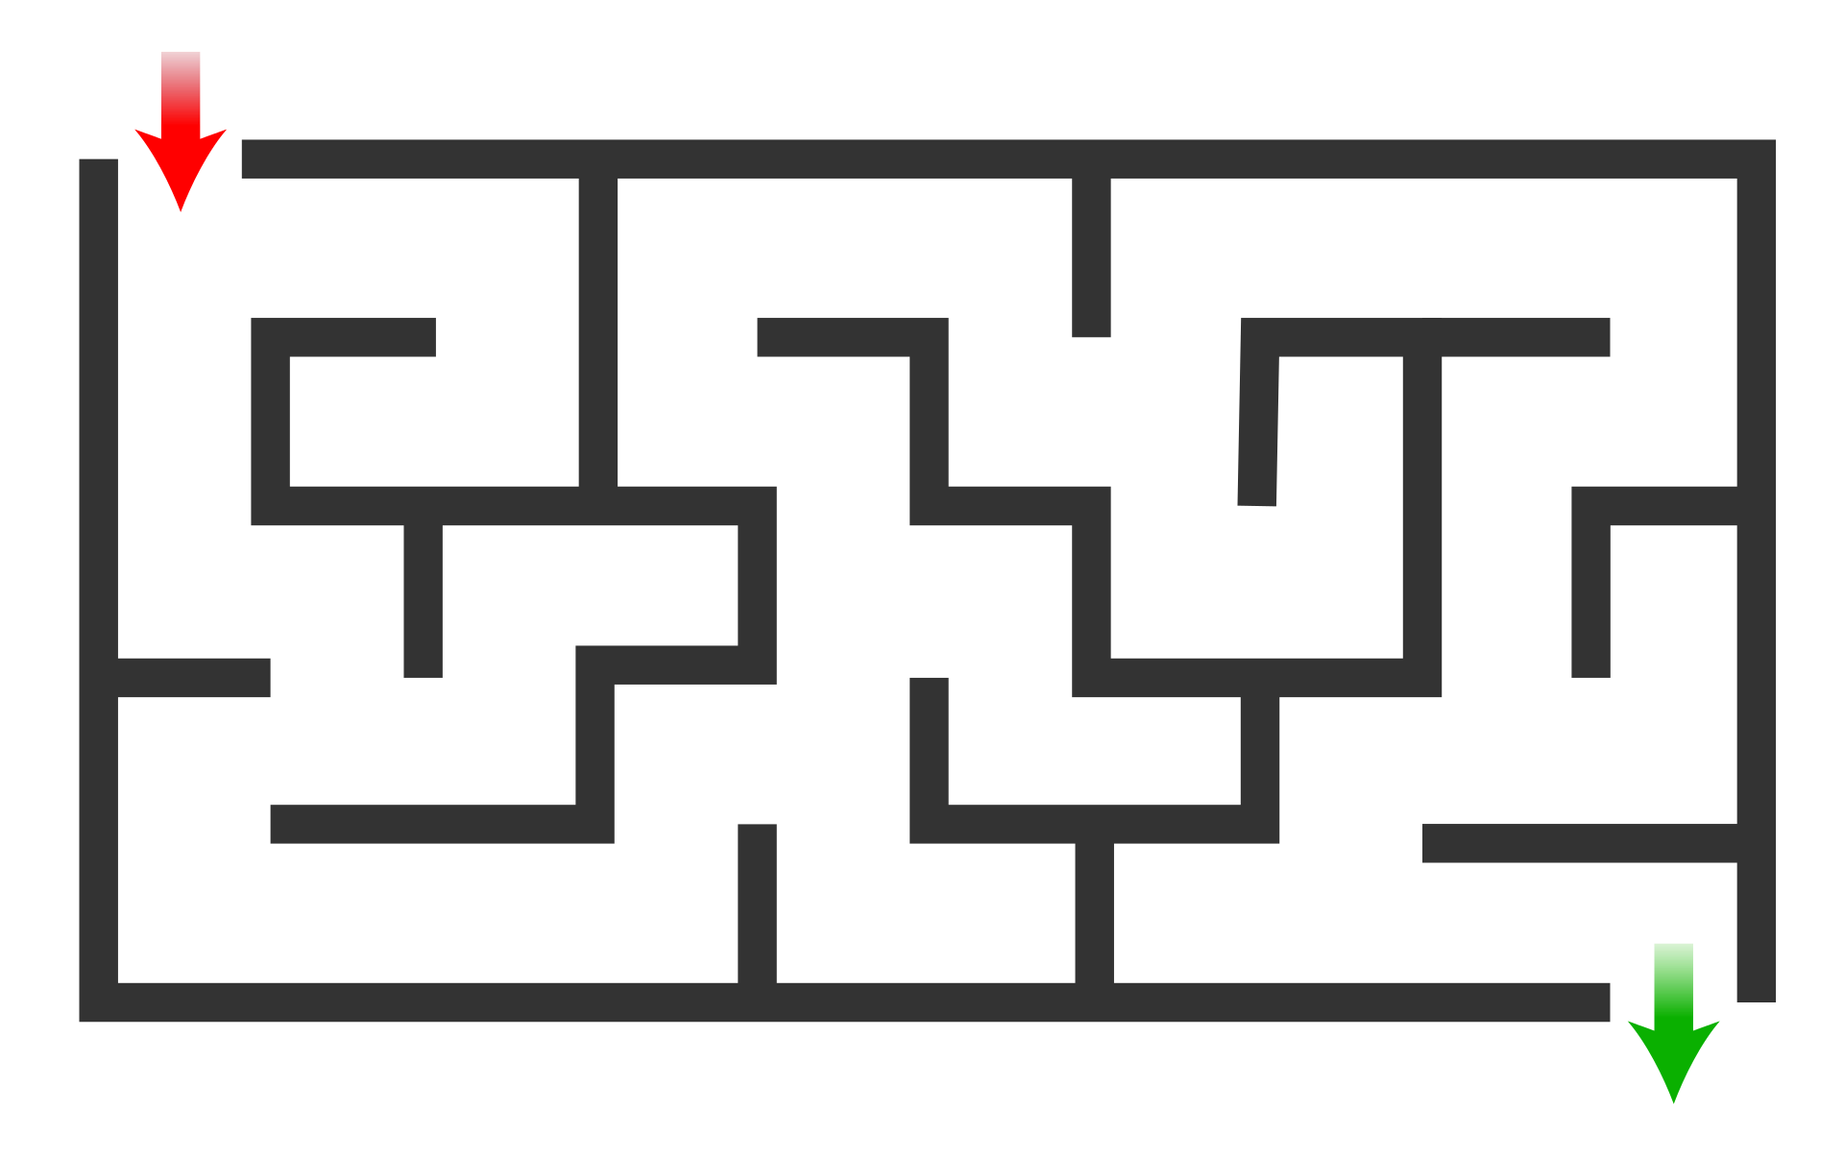
Maze Activity

Slide 12
DWI

Slide 13
It Will Only Take 5 Seconds….
Five seconds is the average time your eyes are off the road while texting. When traveling at 55mph, that's enough time to cover the length of a football field blindfolded. (2009, Virginia Tech Transportation Institute)

Slide 14
Increased Risk
Talking alone reduces the amount of brain activity devoted to driving by 37%.

Slide 16
Text Messaging
Text messaging requires:
Visual – Taking your eyes off the road
Manual – Taking your hands off the wheel
Cognitive - Taking your mind off of driving
It is by far the most alarming distraction

Slide 17
Justification

Slide 18
State Laws

Slide 19
Virginia Laws
Commercial Vehicles
Commercial vehicles are prohibited from texting and driving
Commercial vehicles may talk on cell phones hands free only
Texting while driving is now a primary offense
Law enforcement may now stop you specifically for a texting violation
School Buses
Hand held and hands free prohibited
Others
No texting
Hand held and hands free prohibited For novice drivers

Slide 20
How much does texting and driving cost?
Violation of the law is a misdemeanor, punishable by a fine of $25 for a first offense, $50 for a second offense, and $75 for a third offense. The penalty for a first offense for violating the texting law is a fine of $20 to $400 and up to four points on the driving record of the offender.

Slide 21
How much does the average accident cost?
Motor vehicle accident average costs: Average cost for each death in a motor vehicle accident: $1,130,000. Average cost for each nonfatal disabling injury: $61,600. Average cost for each property damage crash (includes non-disabling injuries): $7,500.
Can you go to jail for texting and driving?
Anyone convicted of texting and driving who causes serious injury or death to others faces a fine of up to $4,000 and as long as one year in jail. As of Aug 31, 2017

Slide 23
More Information
www.distraction.gov/teens
http://www.drivesmartva.org/

